Slide 1
INF 213 – Web Technology 1
Lecture 2:
Chapter 2: Understanding HTML, XHTML and HTML5 Connections

Slide 2
Hypertext Markup Language (HTML)
describes the content and structure of information on a web page
  not the same as the presentation (appearance on screen)
surrounds text content with opening and closing tags
each tag's name is called an element
  syntax: <element> content </element>
  example: <p>This is a paragraph</p>
An attribute is an extra piece of information associated with a tag that provides further details about the tag.
most whitespace is insignificant in HTML (ignored or collapsed to a single space)
we will use a newer version called HTML5

Slide 3
History of HTML
1991
HTML first published
1995
HTML 2.0
After HTML 4.01 was released, focus shifted to XHTML and its stricter standards.
1997
HTML 3.2
1999
HTML 4.01
XHTML 2.0 had even stricter standards than 1.0, rejecting web pages that did not comply. It fell out of favor gradually and was abandoned completely in 2009.
2000
XHTML 1.0
2002 -2009
HTML5 is much more tolerant and can handle markup from all the prior versions.
XHTML 2.0
HTML5
Though HTML5 was published officially in 2012, it has been in development since 2004.
2012

Slide 4
What is HTML5?
HTML5 is the newest version of HTML, only recently gaining partial support by the makers of web browsers.
It incorporates all features from earlier versions of HTML, including the stricter XHTML.
It adds a diverse set of new tools for the web developer to use.
It is still a work in progress. No browsers have full HTML5 support. It will be many years – perhaps not until 2018 or later - before being fully defined and supported.

Slide 5
Goals of HTML5
Support all existing web pages. With HTML5, there is no requirement to go back and revise older websites.
Reduce the need for external plugins and scripts to show website content.
Improve the semantic definition (i.e. meaning and purpose) of page elements.
Make the rendering of web content universal and independent of the device being used.
Handle web documents errors in a better and more consistent fashion.

Slide 6
New Elements in HTML5
<article>
<aside>
<audio>
<canvas>
<datalist>
<figure>
<figcaption>
<footer>
<header>
<hgroup>
<mark>
<nav>
<progress>
<section>
<source>
<svg>
<time>
<video>
These are just some of the new elements introduced in HTML5. We will be exploring each of these during this course.

Slide 7
Other New Features in HTML5
Built-in audio and video support (without plugins)
Enhanced form controls and attributes
The Canvas (a way to draw directly on a web page)
Drag and Drop functionality
Support for CSS3 (the newer and more powerful version of CSS)
More advanced features for web developers, such as data storage and offline applications.

Slide 8
First Look at HTML5
Remember the DOCTYPE declaration from XHTML?
<!DOCTYPE html PUBLIC "-//W3C//DTD XHTML 1.0 Transitional//EN"
"http://www.w3.org/TR/xhtml1/DTD/xhtml1-transitional.dtd">
In HTML5, there is just one possible DOCTYPE declaration and it is simpler:
<!DOCTYPE html>
Just 15 characters!
The DOCTYPE tells the browser which type and version of document to expect. This should be the last time the DOCTYPE is ever changed. From now on, all future versions of HTML will use this same simplified declaration.

Slide 9
The <html> Element
This is what the <html> element looked like in XHTML:
<html xmlns="http://www.w3.org/1999/xhtml" xml:lang="en" lang="en">
Again, HTML5 simplifies this line:
<html lang="en">
The lang attribute in the <html> element declares which language the page content is in. Though not strictly required, it should always be specified, as it can assist search engines and screen readers.
Each of the world’s major languages has a two-character code, e.g. Spanish = "es", French = "fr", German = "de", Chinese = "zh", Arabic = "ar".

Slide 10
The <head> Section
Here is a typical XHTML <head> section:
<head>
<meta http-equiv="Content-type" content="text/html; charset=UTF-8" />
<title>My First XHTML Page</title>
<link rel="stylesheet" type="text/css" href="style.css" />
</head>
And the HTML5 version:
<head>
<meta charset="utf-8">
<title>My First HTML5 Page</title>
<link rel="stylesheet" href="style.css">
</head>
Notice the simplified character set declaration, the shorter CSS stylesheet link text, and the removal of the trailing slashes for these two lines.

Slide 11
Basic HTML5 Web Page
Putting the prior sections together, and now adding the <body> section and closing tags, we have our first complete web page in HTML5:
<!DOCTYPE html>
<html lang="en">
<head>
<meta charset="utf-8">
<title>My First HTML5 Page</title>
<link rel="stylesheet" href="style.css">
</head>
<body>
<p>HTML5 is fun!</p>
</body>
</html>
Let's open this page in a web browser to see how it looks…

Slide 12
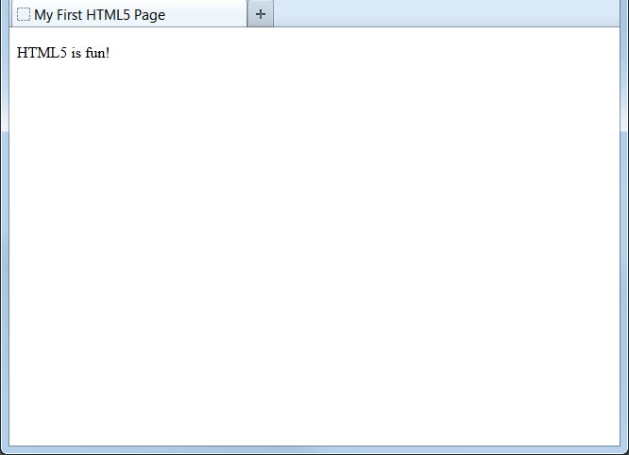
Viewing the HTML5 Web Page
Even though we used HTML5, the page looks exactly the same in a web browser as it would in XHTML. Without looking at the source code, web visitors will not know which version of HTML the page was created with.

Slide 13
Page title: <title>
describes the title of the web page
<title>Chapter 2: HTML Basics</title>
  The <title> tag is required in all HTML documents
  placed within the head of the page
  Note: You can NOT have more than one <title> element in an HTML document.
  displayed in the web browser's title bar and when bookmarking the page

Slide 14
Paragraph: <p>
paragraphs of text (block)
<p>You're not your job.
You're not how much money you have in the bank.
You're not the car you drive. You're not the contents
of your wallet. You're not your khakis. You're
the all-singing, all-dancing crap of the world.</p>
You're not your job. You're not how much money you have in the bank. You're not the car you drive. You're not the contents of your wallet. You're not your khakis. You're the all-singing, all-dancing crap of the world.
placed within the body of the page

Slide 15
Headings: <h1>, <h2>, ..., <h6>
headings to separate major areas of the page (block)
<h1>University of Whoville</h1>
<h2>Department of Computer Science</h2>
<h3>Sponsored by Micro$oft</h3>
University of Whoville
Department of Computer Science
Sponsored by Micro$oft

Slide 16
Links: <a>
links, or "anchors", to other pages (inline)
<p>
Search
<a href="http://www.google.com/">Google</a> or our
<a href="lectures.html">Lecture Notes</a>.
</p>
Search Google or our Lecture Notes.
uses the href attribute to specify the destination URL. Can be absolute or relative
  A relative address describes the path from one web page to another (to another page on this site)
  E.g. <a href=”/elephants/african.html”>Learn about African elephants.</a>
An Absolute link describes the path from one web page to a full Internet address (to another web site).
  E.g. <a href=”http://www.yourdomain.com/zoo.html”>Return to the zoo.</a>

Slide 17
Links: <anchor>
Links can also be used to jump to other places on the same page.
Two steps:
  Create a link pointing to the anchor
  <a name="chapter4"></a>
    Create the anchor itself.
  Click <a href="#chapter4">here</a> to read chapter 4.
  A # in front of a link location specifies that the link is pointing to an anchor on a page.
  Anchor meaning a specific place in the middle of your page.
  anchors are inline elements; must be placed in a block element such as p or h1
  The <a href> is what you click and <a id> or <a name> is where you go when you click there.

Slide 18

Block and inline elements
block elements contain an entire large region of content
  examples: paragraphs, lists, table cells
  the browser places a margin of whitespace between block elements for separation
inline elements affect a small amount of content
  examples: bold text, code fragments, images
  the browser allows many inline elements to appear on the same line
  must be nested inside a block element

Slide 19
Quotations <blockquote>
a lengthy quotation (block)
<p>As Lincoln said in his famous Gettysburg Address:</p>
<blockquote>
<p>Fourscore and seven years ago, our fathers brought forth
on this continent a new nation, conceived in liberty, and
dedicated to the proposition that all men are created equal.</p>
</blockquote> HTML
As Lincoln said in his famous Gettysburg Address:
Fourscore and seven years ago, our fathers brought forth on this continent a new nation, conceived in liberty, and dedicated to the proposition that all men are created equal. output

Slide 20
Inline quotations <q>
a short quotation (inline)
<p>Quote the Raven, <q>Nevermore.</q></p> HTML
Quote the Raven, “Nevermore.” output
Why not just write the following?
<p>Quote the Raven, "Nevermore."</p>

Slide 21
Computer code <code>
a short section of computer code (usually shown in a fixed-width font)
<p>
The <code>ul</code> and <code>ol</code>
tags make lists.
</p> HTML
The ul and ol tags make lists. output

Slide 22
Preformatted text <pre>
a large section of pre-formatted text (block)
<pre>
Bill Gates speaks
You will be assimilated
Microsoft fans delirious
</pre> HTML
Bill Gates speaks
You will be assimilated
Microsoft fans delirious output
Displayed with exactly the whitespace / line breaks given in the text
Shown in a fixed-width font by default

Slide 23
Line break: <br>
forces a line break in the middle of a block element (inline)
<p>
  The woods are lovely, dark and deep, <br /> But I have promises to
  keep, <br /> And miles to go before I sleep, <br /> And miles to go
  before I sleep.
  </p>
The woods are lovely, dark and deep,
But I have promises to keep,
And miles to go before I sleep,
And miles to go before I sleep.
Warning: Don't over-use br (guideline: >= 2 in a row is bad)

Slide 24
HTML Character Entities
a way of representing any Unicode character within a web page
Unicode is a computing industry standard for the consistent encoding, representation, and handling of text expressed in most of the world's writing systems.
character(s) | entity
< > | &lt; &gt;
é è ñ | &eacute; &egrave; &ntilde;
™ © | &trade; &copy;
π δ Δ | &pi; &delta; &Delta;
И | &#1048;
" & | &quot; &amp;
Complete list of HTML entities

Slide 25
Unicode
Unicode is a computing industry standard for the consistent encoding, representation, and handling of text expressed in most of the world's writing systems.
The standard is maintained by the Unicode Consortium,
As of June 2018 the most recent version, Unicode 11.0, contains a repertoire of 137,439 characters covering 146 modern and historic scripts, as well as multiple symbol sets and emoji.

Slide 26
Deletions and insertions: <del>, <ins>
content that should be considered deleted or added to the document (inline)
<p>
<del>Final Exam</del> <ins>Midterm</ins> is on <del>Aug 29</del> <ins>Apr 17</ins>.
</p> HTML
Final Exam Midterm is on Aug 29 Apr 17. output

Slide 27
Abbreviations: <abbr>
an abbreviation, acronym, or slang term (inline)
<p>
Safe divers always remember to check their
<abbr title="Self-Contained Underwater Breathing Apparatus">SCUBA</abbr> gear.
</p> HTML
Safe divers always remember to check their SCUBA gear. output
The title will appear when the abbreviated word is hovered over
In some browsers the abbreviated word will have a dashed underline

Slide 28
Phrase elements : <em>, <strong>
em: emphasized text (usually rendered in italic)
strong: strongly emphasized text (usually rendered in bold)
<p>
HTML is <em>really</em>,
<strong>REALLY</strong> fun!
</p>
HTML is really, REALLY fun!
as usual, the tags must be properly nested for a valid page

Slide 29
Nesting tags
<p>
HTML is <em>really,
<strong>REALLY</em> lots of</strong> fun!
</p>
tags must be correctly nested
  (a closing tag must match the most recently opened tag)
the browser may render it correctly anyway, but it is invalid HTML
  (how would we get the above effect in a valid way?)

Slide 30

Images: <img>
inserts a graphical image into the page (inline)
<img src="images/koalafications.jpg" alt="Koalified koala" />
the src attribute specifies the image URL
HTML5 also requires an alt attribute describing the image

Slide 31
Comments: <!-- ... -->
comments to document your HTML file or "comment out" text
<!-- My web page, by Suzy Student
CSE 190 D, Spring 2048 -->
<p>CSE courses are <!-- NOT --> a lot of fun!</p>
CSE courses are a lot of fun!
many web pages are not thoroughly commented (or at all)
still useful at top of page and for disabling code
comments cannot be nested and cannot contain a --

Slide 32
Unordered list: <ul>, <li>
<ul>
<li>No shoes</li>
<li>No shirt</li>
<li>No problem!</li>
</ul> HTML
No shoes
No shirt
No problem! output
ul represents a bulleted list of items (block)
li represents a single item within the list (block)

Slide 33
More about unordered lists
<ul>
<li>Harry Potter characters:
<ul>
<li>Harry Potter</li>
<li>Hermione</li>
<li>Ron</li>
</ul>
</li>
<li>LOTR characters:
<ul>
<li>Frodo</li>
<li>Bilbo</li>
<li>Sam</li>
</ul>
</li>
</ul> HTML
Harry Potter characters:
  Harry Potter
  Hermione
  Ron
LOTR characters:
  Frodo
  Bilbo
  Sam
output

Slide 34
Ordered list <ol>
<p>Apple business model:</p>
<ol>
<li>Beat Microsoft</li>
<li>Beat Google</li>
<li>Conquer the world!</li>
</ol> HTML
Apple business model:
Beat Microsoft
Beat Google
Conquer the world output
ol represents a numbered list of items
we can make lists with letters or Roman numerals using CSS (later)

Slide 35
Definition list <dl>, <dt>, <dd>
<dl>
<dt>newbie</dt> <dd>one who does not have mad skills</dd>
<dt>own</dt> <dd>to soundly defeat (e.g. I owned that newbie!)</dd>
<dt>frag</dt> <dd>a kill in a shooting game</dd>
</dl> HTML
newbie
one who does not have mad skills
own
to soundly defeat (e.g. I owned that newbie!)
frag
a kill in a shooting game output
dl represents a list of definitions of terms
dt represents each term, and dd its definition

Slide 36
Web page metadata: <meta>
information about your page (for a browser, search engine, etc.)
<meta charset="utf-8" />
<meta name="description“ content="Authors' web site for Building Java Programs." />
<meta name="keywords" content="java, textbook" /> HTML
placed in the head section of your HTML page
meta tags often have both the name and content attributes
  some meta tags use the http-equiv attribute instead of name
  the meta tag with charset attribute indicates language/character encodings
using a meta tag Content-Type stops validator "tentatively valid" warnings

Slide 37
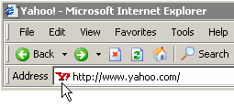

Favorites icon ("favicon")
<link href="filename" type="MIME type" rel="shortcut icon" /> HTML
<link href="yahoo.gif" type="image/gif" rel="shortcut icon" /> HTML
output
the link tag, placed in the head section, attaches another file to the page
  in this case, an icon to be placed in the browser title bar and bookmarks
IE6: Doesn't work; must put a file favicon.ico in the root of the web server

Slide 38
Web Standards
It is important to write proper HTML code and follow proper syntax.
Why use valid HTML and web standards?
  more rigid and structured language
  more interoperable across different web browsers
  more likely that our pages will display correctly in the future
  can be interchanged with other XML data: SVG (graphics), MathML, MusicML, etc.

Slide 39
Tips for Testing Web Pages
Before you transfer your files, test them locally on your machine to ensure that the links work and the content reflects the visual design you intended. After you transfer the pages to a web server or removable device, test them all again.
Perform these tests with as many browsers that you can—Chrome, Firefox, Internet Explorer, Opera, and Safari is a good list—and onboth Mac and Windows platforms. If possible, check at low resolution (800×600) and high resolution (1600×1200).
Turn off auto image loading in your web browser before you start testing so that you can see what each page looks like without the graphics. Check your alt tag messages, and then turn image loading back on to load the graphics and review the page carefully again.
Use your browser’s font size settings to look at each page in various font sizes to ensure that your layout doesn’t fall to pieces if users override your font specifications with their own.
Wait for each page to completely finish loading, and then scroll all the way down to make sure that all images appear where they should.
Time how long it takes each page to load. Does it take more than a few seconds to load? If so, is the information on that page valuable enough to keep users from going elsewhere before the page finishes loading?

Slide 40
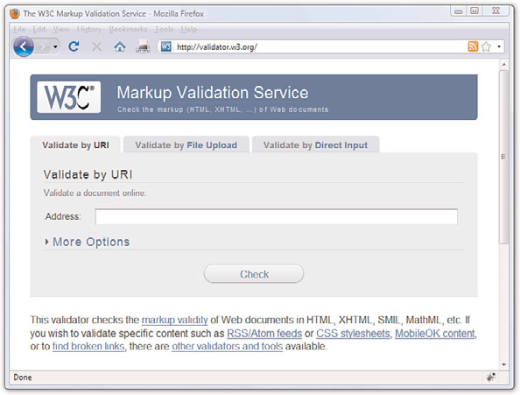
Validating a Web Page
One way to test your pages is to validate them
Validation is the process of testing your pages with a special application that searches for errors and makes sure your pages follow the strict XHTML/HTML 5 standard.
The standards body responsible for developing web standards—the World Wide Web Consortium (W3C)—offers an online validation tool you can use.
  URL: http://validator.w3.org/.

Slide 41
W3C HTML Validator
<p>
<a href="http://validator.w3.org/check/referer">
<img src="http://webster.cs.washington.edu/w3c-html.png" alt="Validate" />
</a>
</p>
validator.w3.org
checks your HTML code to make sure it follows the official HTML syntax
more picky than the browser, which may render bad HTML correctly
Validation informs you whether your pages are constructed properly
Assists in finding and fixing problems before you post pages for the world to see.

Slide 42
Managing a Website
Store web content (html file, css, images, etc.) for an individual website in the same folder.
put your files into directories (or folders, if you will) whose names reflect the content within them. For example, all your images could be in an “images” directory, corporate information could be in an “about” directory, and so on.

Slide 43
Assignment 1
Study the attached word document and complete the anchor tags for the attached html document.
Insert at least two recent images of yourself in the page.
Write a brief proposal about yourself.
Save your work as MYIndexnumber.html
Email your completed document to: halimasadi56@gmail.com.
  Subject : INF 213 Assignment 1

